Slide 1

NOMENCLATURE WORKSHOP
PROJECT ATRA
March 6, 2023
BASEL BOSTON CHARLOTTE CHICAGO DALLAS FRANKFURT LONDON LOS ANGELES MIAMI MONTRÉAL MUMBAI
NEW YORK OTTAWA ROCKVILLE SAN FRANCISCO SAN JUAN SÃO PAULO SEOUL TOKYO TORONTO

Slide 2

Table of Contents
Introduction
Meeting Objectives
Name Development Process
Topline Creative Direction
ATRA Naming Direction
ATRA Conflicts Snapshot
Name Candidate Evaluation
Q & A - Discuss Next Steps
Project Timeline

Slide 3
Introduction
Brand Institute is pleased to work with Chinook Therapeutics on the brand/proprietary name development for atrasentan, under development for the treatment of:
IgA nephropathy
Proteinuric glomerular disease
This product will be marketed in the U.S., Europe, and Canada.
Brand Institute services will include Creative, Trademark Screening, Linguistics, Market & Safety Research.
Brand names must be acceptable from legal, regulatory, commercial, and linguistics perspectives and should support the product’s points of differentiation through messaging and tonality.

Slide 4
Meeting Objectives
During this Nomenclature Workshop we will:
Review and discuss potential name candidates
Select name candidates that meet the branding objectives
Identify concepts, key words, imagery and messages to explore/avoid
Create new names based on names/concepts presented
Discuss next steps

Slide 5
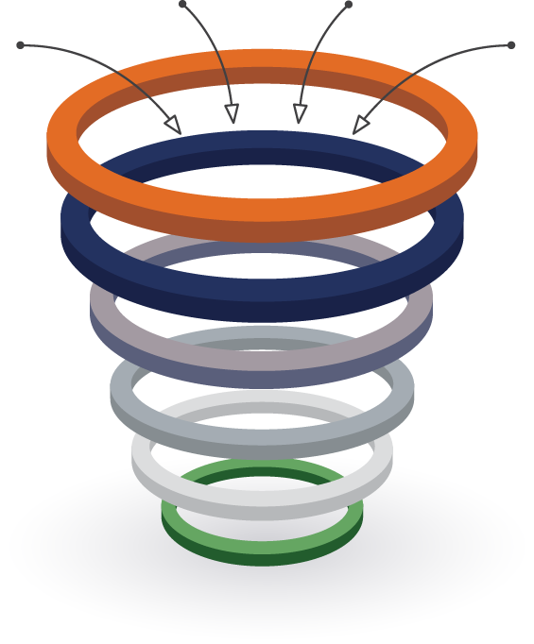
Name Development Process | Overall Process Summary
NAMES
NAMES
BSR Project Team Meeting #1
BI Creative, Computerized, Project Team
Working Project Team (Comm, Reg, Legal, Project Mgmt)
1000+
Names Created
Nomenclature Workshop
Project Team Meeting #2
Working Project Team (Comm, Reg, Legal, Project Mgmt)
75
Names Reviewed
BrandSearch™ Trademark Screening
Comm/Legal
50+
Names Screened
BrandMatrix™ Name Prioritization Survey
Marketing & Safety Research and Linguistics
20
Names Tested
Market Research Final Recommendations
Project Team Meeting #3
Working Project Team (Comm, Reg, Legal, Project Mgmt)
6–8
Names Recommended
(Primary & Secondary)
FULL LEGAL SEARCHES &
REGULATORY SUBMISSION

Slide 6
Topline Creative Direction
Explore
Start with ATRA-
Atrasentan
Kidney related:
Kid/Kyd, Neph
A- prefix
PRO: Proactive, protect, proteinuria
Anti-inflammation
Anti-fibrotic
Preserve/Protect Kidney function
Proactive approach
Taking charge of your health
Prevent End Stage Kidney Disease
ETA/ERA - endothelin A receptor inhibitor
Direct effect
EGFR

Slide 7
Topline Creative Direction
Avoid
Filspari
Starting with T-, TRA-
Relation to TARPEYO (Nefecon) and competitors
Travere
Sparsentan
Chinook
War/weapon/military references
Indication (IgAN)

Slide 8
ATRA Naming Direction
ATRA- in the name or as a prefix
Using ATRA in the name with all four letters means we need to have at least an 8-letter name in order to have approval in the EMA
Less than 50% of INN can be used to create a brand name, and less than 50% of the brand name can correspond to the INN – both visual/verbal similarity
In addition, there are several approved drug names causing conflicts for the names to fail POCA (the pass/fail algorithm FDA/EMA use).
We can still explore ATRA- if the name is a minimum of 8 letters or used in the infix or suffix position. Or potentially ATR as a prefix alternative.

Slide 9
ATRA Conflicts Snapshot
ATRAKYD | ATRALIA | ATRALIAN | ATRALLA | ATRANEPH | ATRAPRO | ATRATECT | ATRAVAR | ATRAVARTA | ATRAVAS | ATRAVESS | ATRAVI | ATRAVIV | ATRAVYA | ATRAZEP | ATRAZYN
ATROFED | AREDIA | ACCLEAN | ABSTRAL | ARANESP | ACCUPRO | ACUTECT | ABLAVAR | ALTAVERA | ABREVA | ALTAVERA | ARAVA | ACNEVIR | ABREVA | ATREZA | AFRAZINE
ATROMID | ARTRACIN | ADRENALIN | ADDERALL | ASTRAMORPH | ASTEPRO | ATROFED | ABREVA | ATROVENT | ALTAVERA | ATRALIN | ATRALIN | ALTAVERA | ACANYA | ATROFED | AFREZZA
ATROMID | ATELVIA | AFTERPLAN | ATRALIN | ATROSEPT | ATRALIN | ATROSEPT | ALAVERT | TRAVATAN | ATARAX | ATROVENT | ATREZA | ARTRACIN | AFREZZA | ATROGEN | ALTRESYN
ACTRAPID | ATRALIN | AGRYLIN | ATREZA | ATROVENT | ATREZA | ATROVENT | ALTAVERA | ATROVENT | ATIVAN | INTRAROSA | ATROMID | ATNATIV | ARAVA | ATROMID | ARTRACIN
 | ATREZA | ANTHRALIN | ATRIPLA | TRANMEP | ATRIPLA | ESTRATEST | ARAVA | TRAVATAN | ATREZA | TRAVASE | ATROVENT | ATRALIN | ATREZA | ATROPEN | ATRALIN
 | ATRIPLA | APROLIUM | SAVELLA | ARANESP | ATROPEN | TRIATEX | ATIVAN | ATORVASA | ATROGEN | TRIVASE | UPTRAVI | ATROGEN | ATRIPLA | ATROSEPT | ATROGEN
 | TURALIO | ARALEN | TRAL | ATRIANCE | ATROPINE | ATECTURA | ATREZA | ATORVASTA | ATROPEN | ATROVENT | ARAVA | ATROMID | ABREVA | ATROMID | ATROPEN
 | ADTRALZA | ARTRACIN | ABSTRAL | ATROVENT | AVAPRO | ATROVENT | ATROGEN | ATROFORT | ATROVENT | INTRAROSA | ARTRIVA | ATROPEN | ADTRALZA | ATORZEM | ATRYN
 | AQUALIA | ATRALIN | ACTROL | APRANAX | ATRIPLA | PROTECT | ATROPEN | ATRONATE | OCREVUS | TRAVASE | ATROMID | ATROVENT | ARAVA | ATRALIN | ANIZYN
 | ARALIA | ATROGEN | ADDERALL | ARANESP | ATROPINE | TRIATEC | ATROVENT | ATROVENT | TRAVASE | ALPRESS | ATROVENT | OTRIVIN | ARTRIVA | ATROZOL | ATRACTIN
 | AREDIA | ATROPEN | ADTRALZA | ATRIANCE | AVAPRO | ADRIACEPT | ABLAVAR | ATROVITA | TRIVASE | ASTRALIS | UPTRAVI | TETRAVIV | ATRIPLA | AZEP | ATRALIN
 | ASTRAL | ATROPINE | ARALIA | ATRONASE | ARATRO | ARTROTEC | ABREVA |  | ABREVA | ATORVAS | ARAVA | TRIAVIL | ARAVA | TRAZER | ATRICAN
 | ATRIPLA | AURALGAN | ARTROL | ATRONATE | ARGOPRO | ASS PROTECT | ARAVA |  | ARTRIVA | ATORVASA | ARITAVI | ARTRIVA | ARIDYA |  | ATROPIN
 | AURELIA | TRINALIN | ARTRYL |  | ARTEPRO | ATRACTIN | ARTRIVA |  | ATARAX | ATRONASE | AROVI | ATROMID | ATREMIA |  | ATROSAN
 | ABRILIA | ADRENALIN | ASTRAL |  | ASAPRO | ATROFORT | ATIVAN |  | ATIVAN | ATROVENT | ATRALIN | ATROVENT | ATROPA
 | ADTRALZA | AFRICAN | ATRIPLA |  | ASKA PRO | ATRONATE | ATRIANCE |  | ATROVENT | ATROVITA | ATRAM | OTRIVIN | ATROVITA
 | AMILIA | AGRYLIN | XATRAL |  | ASPRO | ATROVENT | ATROVENT |  | OCREVUS |  | ATROPA | TRIAVIL
 | ANTILIA | ARALEN | ABELLA |  | ASTEPRO | ETRILECT | ARAVA |  | TRAVASE |  | ATROVITA | ATRALIN
 | ARALIS | ARALIA | ADTRALZA |  | ATROPA | HEPATECT | ARTRODAR |  | ADIVAS |  | SASTRAVI | ATROPIN
 | ARILIAR | ATROPINE | ARILLA |  | ATROPIN | INTRATECT | ATORVAL |  | ARAVA |  | UPTRAVI | ATROVENT
 | ARTERIA | AURALGAN | ARMILLA |  | ATROPINA | ITRABEST | ATORVAS |  | AREMAS |  |  | ATROVITA
 | ASTRALIS | CANADIAN | ARTILLA |  | ATROPINO | TRIATEC | ATOVER |  | ASTRALIS |  |  | PRAVIN
 | ATRALIDON | TRINALIN | ASTRALIS |  | DUTRAPRO | VARITECT | ATROSAN |  | ATIVAN
 | ATRALIN | ABRILIA | ATRALIDON |  | PARAPRO |  |  |  | ATORASAT
 | ATRALXITINA | ABROBION | ATRALIN |  |  |  |  |  | ATORVAL
 | ATREMIA | ADRENALIN | ATROALDO |  |  |  |  |  | ATORVAN
 | ATROCELA | AERALIN | ATROCELA |  |  |  |  |  | ATORVAS
 | ATRODIL | AGRELAN | ATROLAK |  |  |  |  |  | ATORVASA
 | ATROLAK | AMPRILAN | ATROPA |  |  |  |  |  | ATORVASTA
 | ATROVITA | ANALIPIN |  |  |  |  |  |  | ATRONASE
 | AZALIA | ANSILAN |  |  |  |  |  |  | ATROSAN
 | DIARALIA | ANTROLIN |  |  |  |  |  |  | ATROST
 | DITRALIA | APREGALIN |  |  |  |  |  |  | ATROVENT
 | TALIA | ARCALION |  |  |  |  |  |  | ATROVITA
 |  | ARILIN |  |  |  |  |  |  | ULTRAVAS
 |  | ASTRALIS
 |  | ATALINE
 |  | ATARALGIN
 |  | ATENOLAN
 |  | ATORVALAN
 |  | ATRACTIN
 |  | ATRALIDON
 |  | ATRALIN
 |  | ATRALXITINA
 |  | ATRICAN
 |  | ATROPIN
 |  | ATROSAN
 |  | TRALINAN
Meets 50% INN EMA Criteria

Slide 10
Name Candidate Evaluation
The following names have been pre-screened for registered identical trademarks in the US Federal, EUTM, WIPO & Canada, and InterNIC registries.
These name candidates appear free of prior registrations for identical marks in identical services and products included in classes 5 and 10. This does not constitute Brand Institute’s BrandSearch™ Intelligent Search (IQ).
Please Note:
(P) Denotes possible promotional elements (further investigation required)
(T) Denotes identical trademark registration
(U/I) Denotes USAN/INN stem
(C) Denotes .com registration
(CB) Denotes ‘built-out’ .com website*
*The term "built-out" means that an actual website exists at this address and is not merely registered. Registered domain names are typically more obtainable than "built-out" websites.

Slide 11



It’s Time to Review and Create!
Step 1. Read the name, consider the rationale, and keep names that are on target.
Target retainment number: at least 50 for Trademarks!
Step 2. Identify roots that are off target and eliminate inappropriate names
Step 3. Create new names based on preferred roots
Project Team creates 2-3 new names per Neutral/Negative candidate

Slide 12
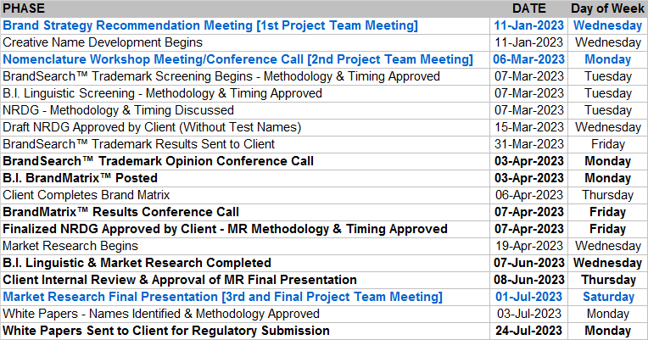
Project Timeline
Bold indicates Project Team involvement

Slide 13
Thank you for your participation! Your referrals are the best compliment. Should your colleagues have questions or naming needs, please feel free to forward our contact information below:
Courtney Kilroy
Divisional President – Northern California & Pacific Northwest
E-mail: ckilroy@brandinstitute.com
Phone: (415) 421-3200
611 Gateway Blvd Suite 200
South San Francisco, CA 94080
USA
March 6, 2023

